Slide 1
A core Course on Modeling
Introduction to Modeling
0LAB0 0LBB0 0LCB0 0LDB0
c.w.a.m.v.overveld@tue.nl
v.a.j.borghuis@tue.nl
S.20

Slide 2
Formalization phase phase: formalize relations
define
formulate
purpose
conceptualize
identify
entities
choose
relations
formalize
obtain
values
formalize
relations
execute
operate
model
obtain
result
conclude
present
result
interpret
result
Notes:
2

Slide 3
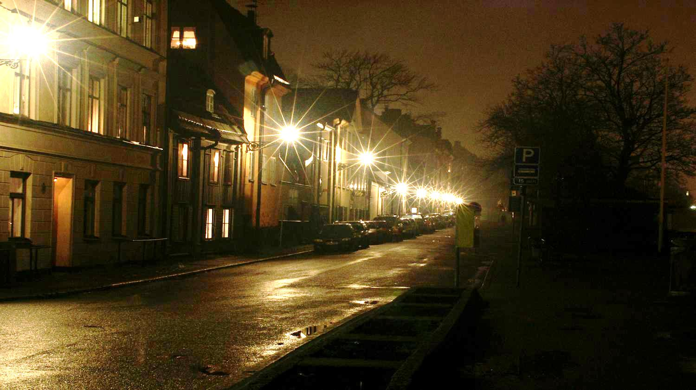
How to optimize road illumination
... such that
energy costs are minimal
no blinding
enough visual contrast
Notes:
3

Slide 4
relations
dimensions
assumptions
todo
enCostpH = ppkWh * totP
[Euro/h] = [Euro/kWh]*[kW]
only electricity costs
enCostpH
blnd
contrast
ppkWh
totP
p
nLanterns
roadLength
dL
maxP
maxInt
minP
minInt
totP = p * nLanterns
[kWh] = [kWh/lntrn ]*[lntrn]
ignore losses in wiring
ppkWh = ...
[Euro/kWh]
from energy supplier
nLanterns =1+roadLength/dL
[lntrn] = [m ]/[m/lntrn]
equal distances
blnd=max(maxP,maxInt)-maxP
[kW/m²]
independent of color, ...
contrast=minP-min(minP,minInt)
[kW/m²]
independent of color, ...
maxP = ...
[kW/m²]
driver visual capabilities
minP = ...
[kW/m²]
driver visual capabilities
roadLength = ...
[m]
from problem owner
p = (choose)
[kW]
from the designer
dL = (choose)
[m]
from the designer
Notes:
4
The trick to express blnd and contrast as numbers that need to be larger than 0, and that are 0 if the conditions are satisfied will be explained later in chapter 5.

Slide 5
How to deal with maxInt and minInt?
Focus on the ‘sees’ relation
adjacent
authority
driver
1
1
expenses
visual capabilities
1
2
pays
1
lantern
operated by
1
height
power
n
n
1
n
sees
car
speed
height
located on
illuminate
n
1
1
consists of
road
1
1
width
surface reflectance
1
traffic
1
density
rides on
Notes:
5

Slide 6
How to deal with maxInt and minInt?
driver
visual capabilities
lantern
height
power
sees
illuminate
road
width
surface reflectance
Notes:
6

Slide 7
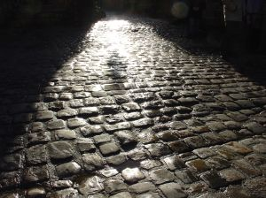
How to deal with maxInt and minInt?
L
E
L
E
r
r
r
http://www.sxc.hu/photo/761125
http://www.sxc.hu/photo/933048
simulation
perceived intensity = f(L,E,r)
perceived intensity = f₁(L,r)*f₂(r,E)
Notes:
7

Slide 8
How to deal with maxInt and minInt?
L
E
L
E
r
r
r
http://www.sxc.hu/photo/761125
http://www.sxc.hu/photo/933048
perceived intensity = f(L,E,r)
perceived intensity = f₁(L,r)*f₂(r,E)
Notes:
8

Slide 9
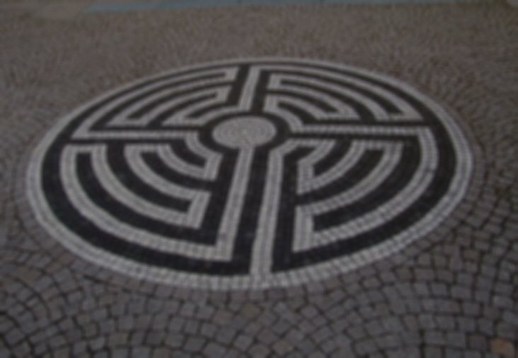
How to deal with maxInt and minInt?
QUIZ
L
E
How does the perceived intensity depend on the location of the driver?
(in other words: what do you know of f₂(r,E)?)
r
r
http://www.sxc.hu/photo/933048
perceived intensity = f₁(L,r)*f₂(r,E)
Notes:
9

Slide 10
How to deal with maxInt and minInt?
L
E
relation road - eye:
intensity f₂(r,E) ≅ c*B(r)
(does hardly depend on E)
r
r
http://www.sxc.hu/photo/933048
perceived intensity = f₁(L,r)*f₂(r,E)
Notes:
10

Slide 11
How to deal with maxInt and minInt?
L
E
relation road - eye:
intensity f₂(r,E) ≅ c*B(r)
(does hardly depend on E)
r
r
QUIZ
How does the intensity in location r depend on the location of a lamp?
(in other words: what do you know about f₁(L,r)?)
http://www.sxc.hu/photo/933048
perceived intensity = f₁(L,r)*f₂(r,E)
Notes:
11

Slide 12
How to deal with maxInt and minInt?
A slightly more accurate formula also takes into account that brightness is reduced when light strikes the road under a skew angle: B(r)=p cos φ/|L-r|², where cos φ = h/|L-r|
L
E
relation road - eye:
intensity f₂(r,E) ≅ c*B(r)
(does hardly depend on E)
r
r
relation lamp – road:
B(r) = f₁(L,r) = p/|L-r|²
http://www.sxc.hu/photo/933048
multiple lamps:
B = B₁ + B₂ + B₃ + ... = Σ_{n}B_{n}
perceived intensity = f₁(L,r)*f₂(r,E)
Notes:
12

Slide 13
How to deal with maxInt and minInt?
Therefore
maxInt = max _{r ∈ road}c*B(r)
= max _{r ∈ road}c*(Σ_{n} p/|L_{n}-r|²)
minInt = min _{r ∈ road}c*B(r)
= min _{r ∈ road}c*(Σ_{n} p/|L_{n}-r|²)
relation road - eye:
intensity f₂(r,E) ≅ c*B(r)
(does hardly depend on E)
relation lamp – road:
B(r) = f₁(L,r) = p/|L-r|²
multiple lamps:
B = B₁ + B₂ + B₃ + ... = Σ_{n}B_{n}
Notes:
13

Slide 14
How to deal with maxInt and minInt?
Compute |L_{n}-r|² using Pythagoras:
|L_{n}-r|² = h² +(w-W_{h})²+(l-n dL)²,
where r = (l,w,0);
W_{h} = ½ width of the road;
h = lantern height.
relation road - eye:
intensity f₂(r,E) ≅ c*B(r)
(does hardly depend on E)
w - Wh
l - n dL
h
relation lamp – road:
B(r) = f₁(L,r) = p/|L-r|²
r
multiple lamps:
B = B₁ + B₂ + B₃ + ... = Σ_{n}B_{n}
Notes:
14

Slide 15
Summary
develop a model using the todo list, introduce quantities when necessary;
translate relations from conceptual model into functions in formal model;
try expressions involving few as possible quantities (e.g., prefer f₁(x,y)*f₂(y,z) over f(x,y,z) );
if possible, try to approximate f₁(x,y) by a simpler f₂(x) for relevant range of y’s
demo
Notes:
15

